Slide 1
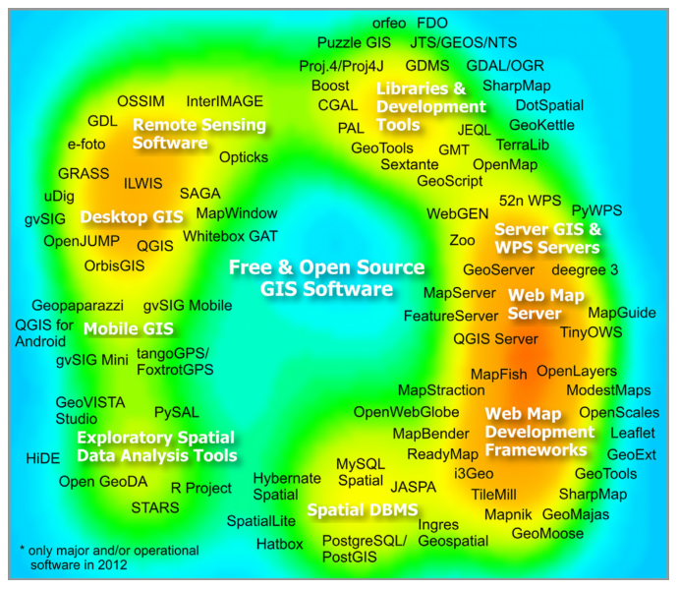
Open Science and Github
Dr. Jerry Shannon

Slide 2


Slide 3
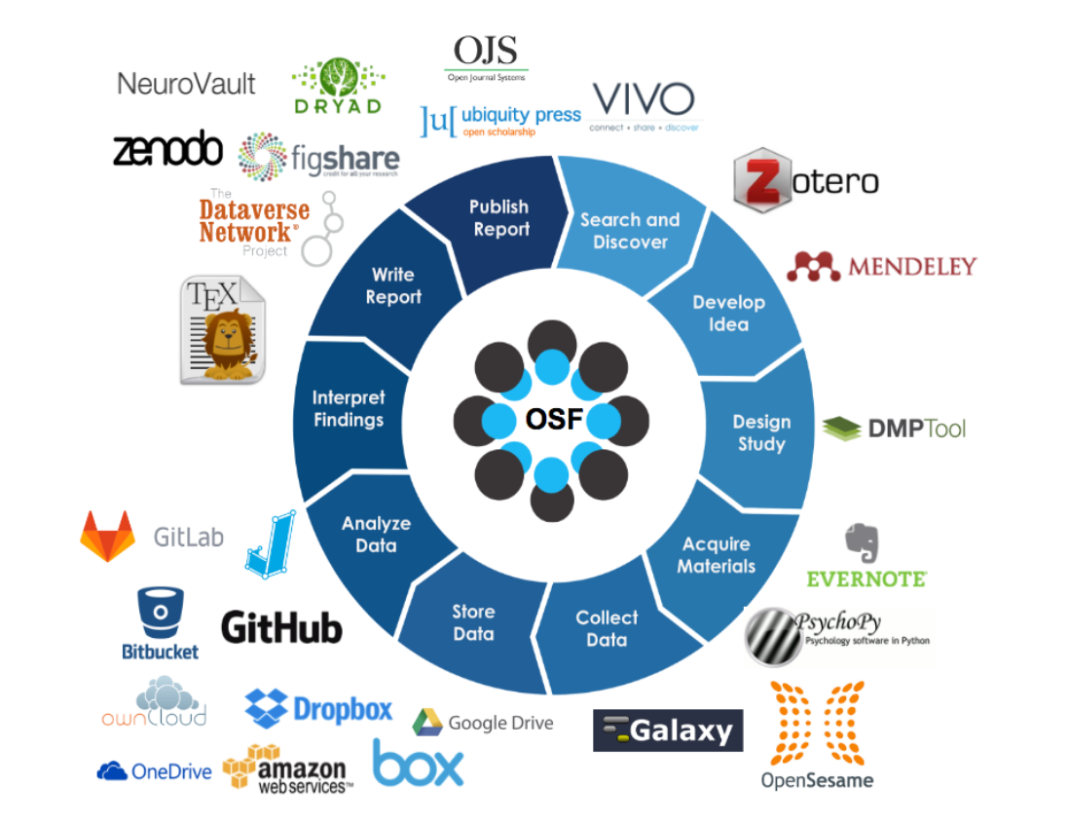

Slide 4







Open GIScience

Slide 5
Open Software
Steiniger, S., & Hunter, A. J. S. (2013). The 2012 free and open source GIS software map – A guide to facilitate research, development, and adoption. Computers, Environment and Urban Systems, 39, 136–150. Link

Slide 6

Desktop GIS

Slide 7

Statistical analysis/modeling

Slide 8
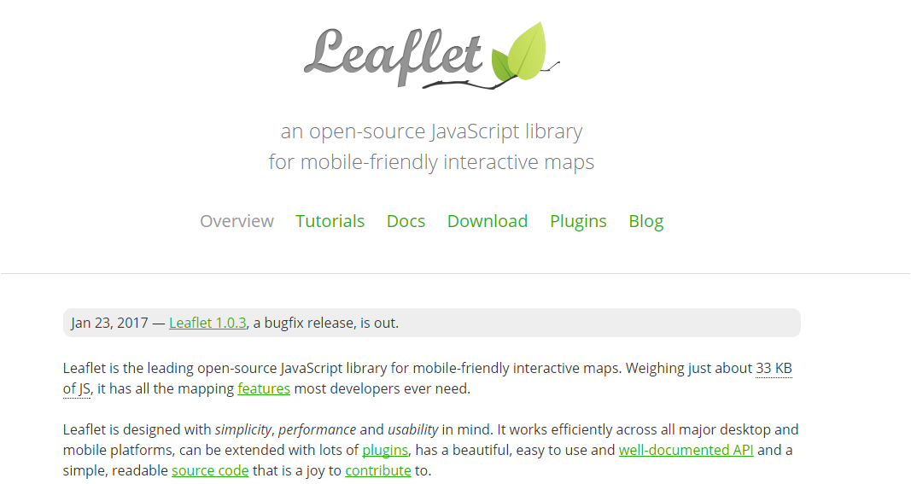
Javascript libraries

Slide 9

Spatial databases

Slide 10
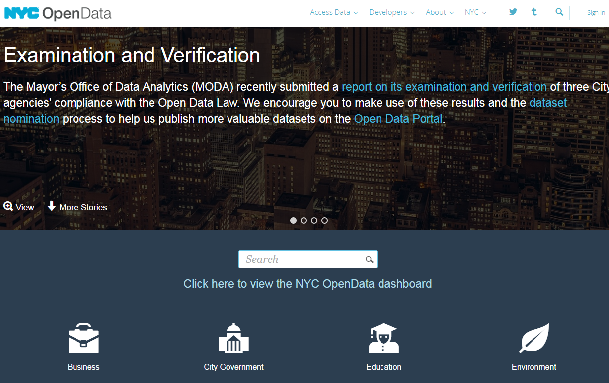
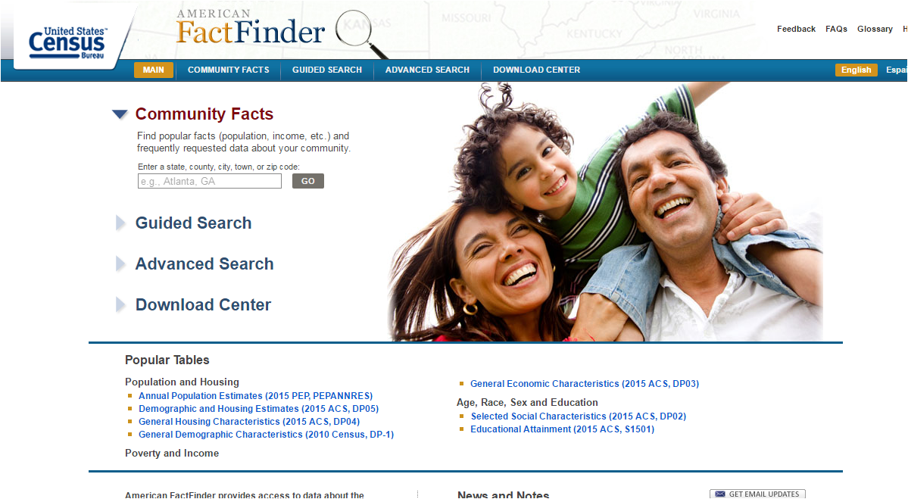
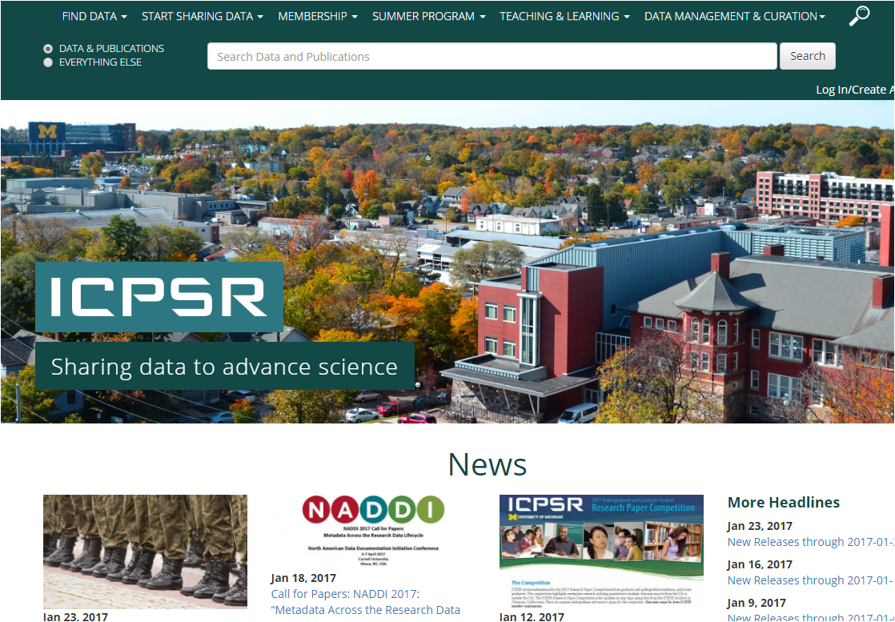
Open Data

Slide 11
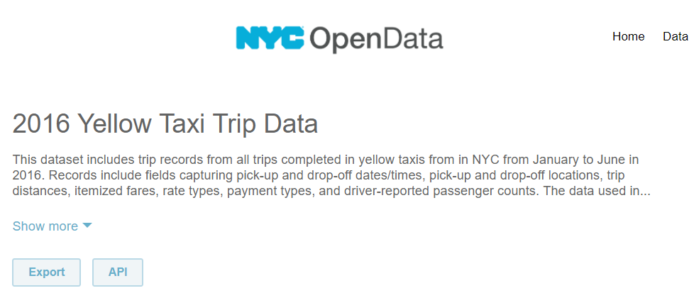

NYC Taxis
Link

Slide 12
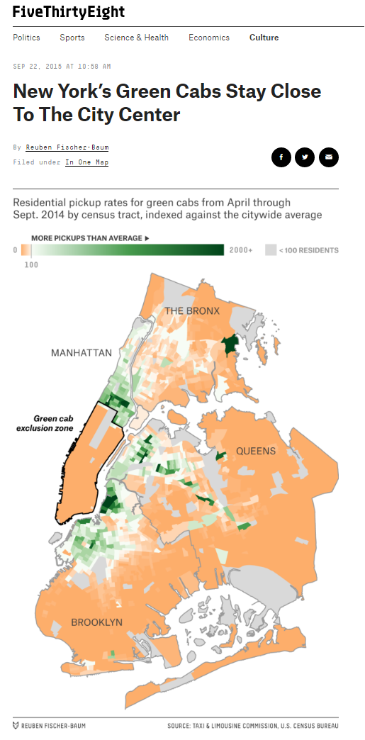
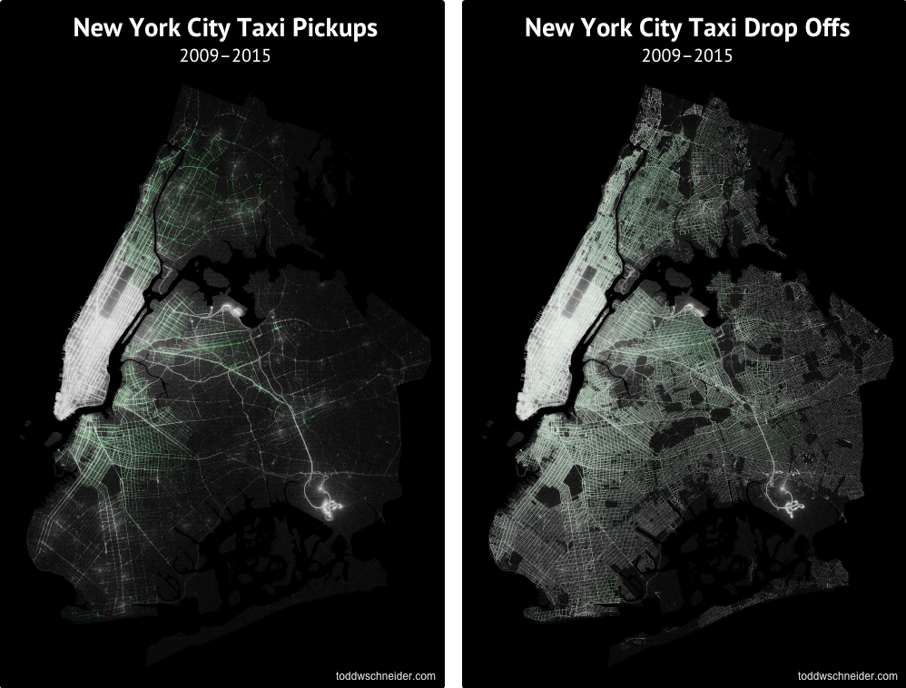
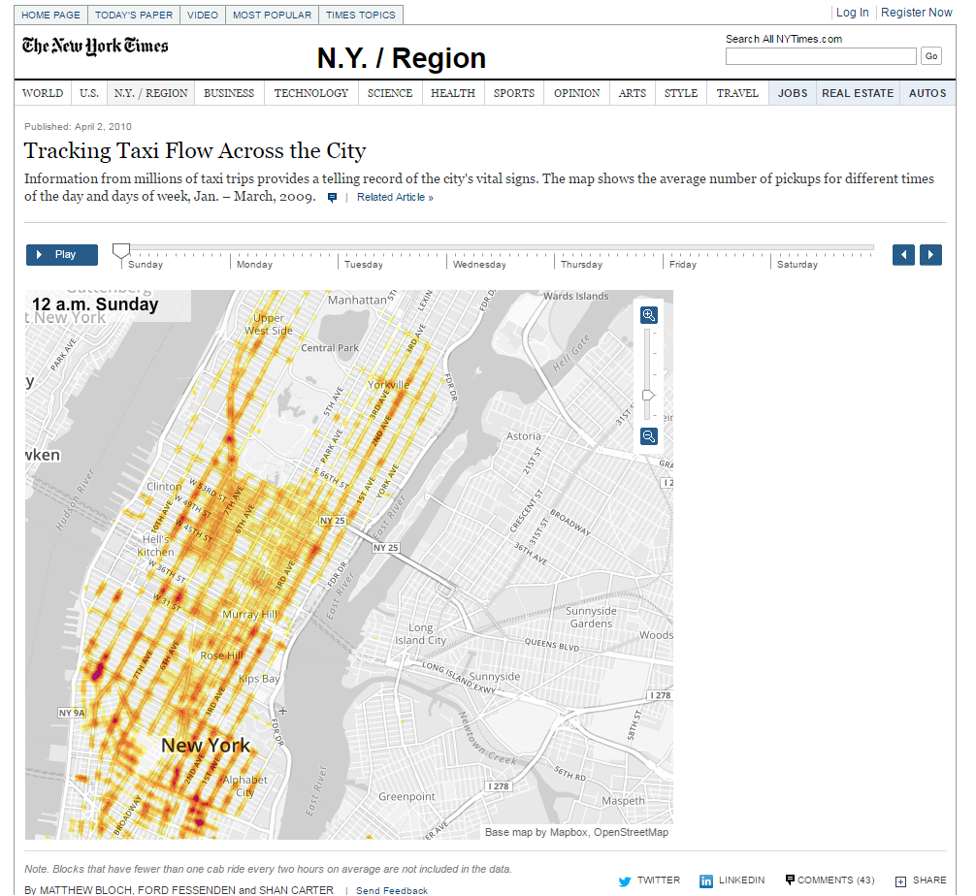
NYC Taxis

Slide 13
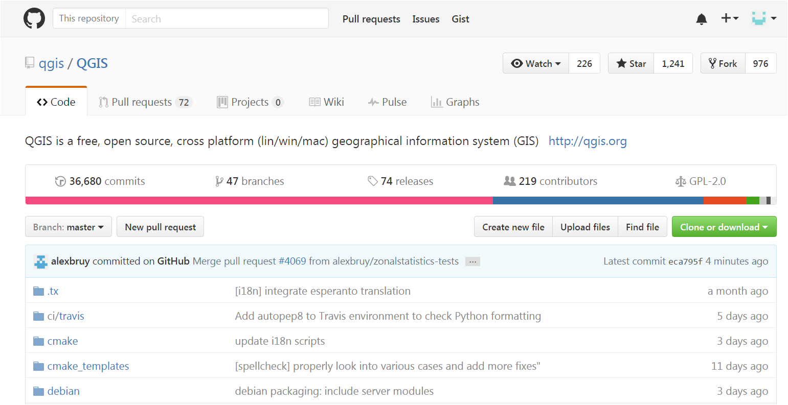
Open Code

Slide 14
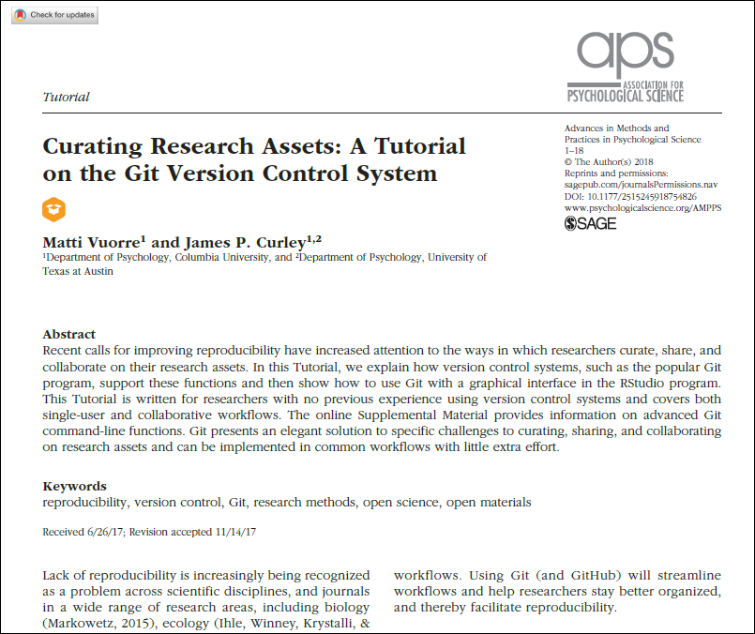
Why use Git/Github?

Slide 15

Your task: Create a Github account and a new repo. Clone it to a working folder.

Slide 16
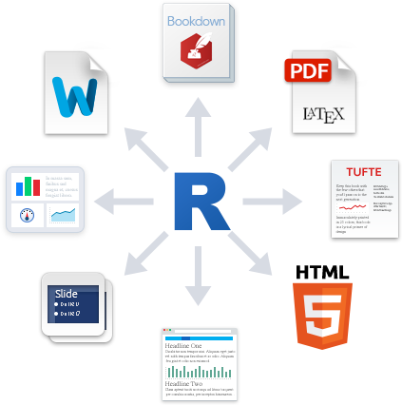


Markdown: A code based formatting tool for text documents.

Slide 17
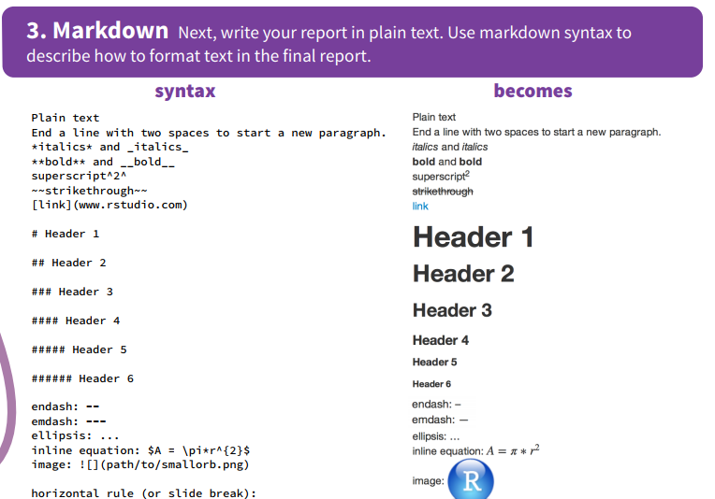

Slide 18
Why are we using Rmarkdown?
Provides an easy way to share code and your results.
Results always match the code
Readable formatting for code
No cutting and pasting needed

Slide 19
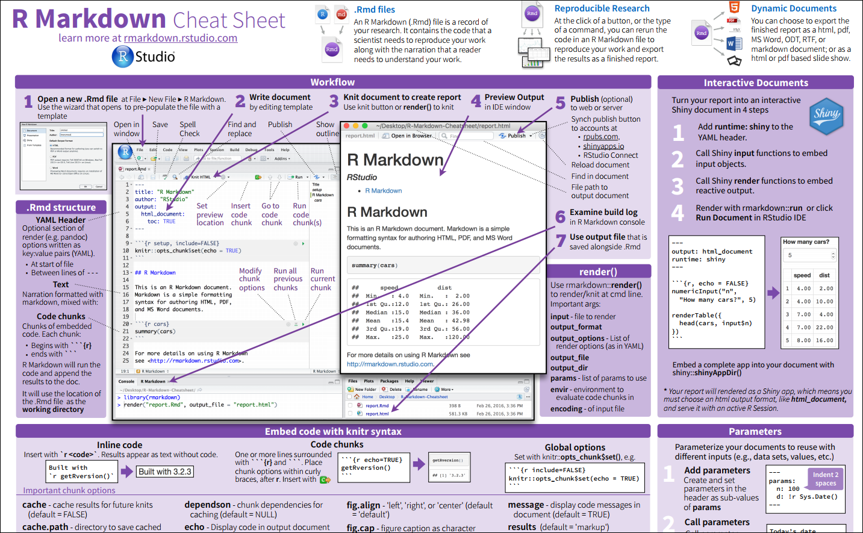
https://www.rstudio.com/wp-content/uploads/2016/03/rmarkdown-cheatsheet-2.0.pdf

Slide 20

Take it up a notch! Create a Markdown document that loads the county data from last week and makes a boxplot of the poverty variable.

Slide 21

Final challenge! Fork the Sandbox repo: https://github.com/jshannon75/sandbox Add a favorite children’s book.

Slide 22
